Slide 1
Chinese
Philosophies
&
Ethical Codes
YHS

Slide 2
Confucianism
Origins:
5-6th century BCE
China (still most widely practiced here
Adherents
5-6 million
Notes:
Western Term

Slide 3
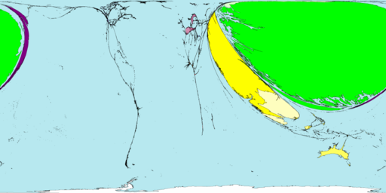
WOW

Slide 4
Confucius
551 – 479 B.C.E.
Ancestors = aristocracy…gone by time born
Dad dies – age 3
Mom – values ed. and teaches him to value it as well.
Appointed to several government posts
Leaves due to discontent with leaders.
Disappears – voluntary exile!
Becomes a Teacher!

Slide 5
Overall…
Highly optimistic view of human nature…
Ordinary people can do GREAT things.
Believed those great things should be tied to service to others.
“Some people are born great, some people achieve greatness and some have greatness thrust upon them.”
-Shakespeare.

Slide 6
5 Principle Relationships
1. Ruler
Subject
2. Father
Son
3. Husband
Wife
4. Older Brother
Younger Brother
5. Older Friend
Younger Friend
Notes:
Notice the line is not ending and goes back and forth.

Slide 7
Organizing Principles
Concerned primarily with restoring social stability and order
What is the basis of a stable, unified, and enduring social order?

Slide 8
Organizing Principles
Status
Age
Gender

Slide 9
Major Confucian Principles
Li --> Rite, rules, ritual decorum (Binding force of an enduring stable society)
Ren --> **Humaneness, benevolence, humanity
Shu --> Reciprocity, empathy
Do not do unto others what you would not want others to do unto you.
Yi --> Righteousness
Xiao --> Filial Piety (Respect your elders!)
Notes:
Humaness is the most important! Tied to the Golden Rule – due unto others what you would have them do to you.

Slide 10
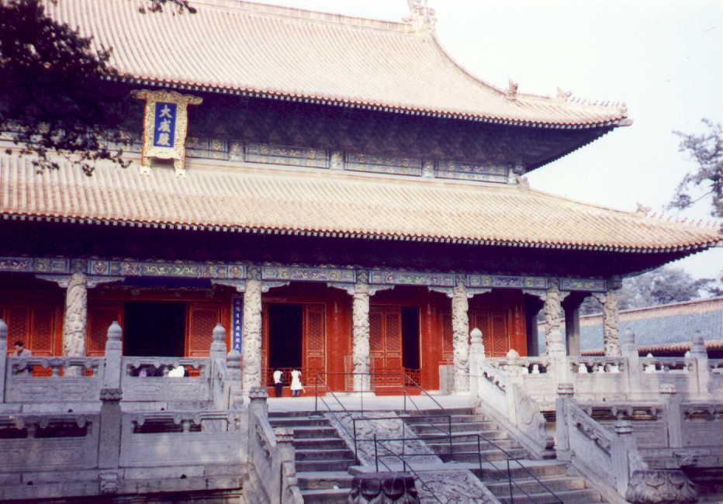
Confucian Temple Complex

Slide 11
Stones Engraved with Confucius' Life Stories

Slide 12
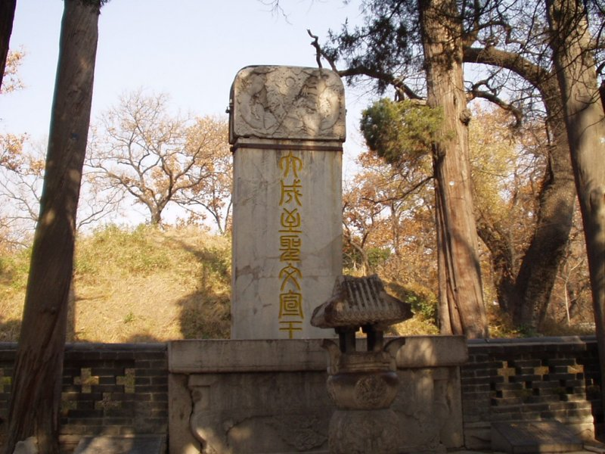
Confucius' Tomb

Slide 13
Keys to Confucianism
If someone does something bad, education, not punishment, is the answer.
Good people will mend their ways in accordance to their inherent goodness
Do you believe that punishment does more harm that good?

Slide 14
Social Cohesion is Paramount
The emperor is the example of proper behavior --> “big daddy”
All should strive to live like the Emperor.

Slide 15
Factoids…
Neither affirms nor denies the existence of heaven
Confucius = Kung-fu-tzu (master kind)

Slide 16
Daoism

Slide 17
Lao Zi [Lao-Tzu]
Not sure when he died. [604 B.C.E. - ?]
His name means “Old Master”

Slide 18
The Dao De Jing
The basic text of Daoism.
In Chinese, it means The Classic in the Way and Its Power.
“Those who speak know nothing: Those who know are silent.”
These words were spoken by Laozi. If we are to believe that Laozi, Was himself one who knew, How is it that he wrote a book, Of five thousand words?

Slide 19
Major Daoist Principles
1. Dao [Tao] is the first-cause of the universe. It is a force that flows through all life.
2. A believer’s goal is to become one with Dao; one with nature
3. Wu wei --> “Let nature take its course.” --> “The art of doing nothing.” --> “Go with the flow!”
4. Man is unhappy because he lives acc. to man-made laws, customs, & traditions that are contrary to the ways of nature.

Slide 20
The "Dao" [Tao]
To escape the “social, political, & cultural traps” of life, one must escape by:
1. Rejecting formal knowledge and learning.
2. Relying on the senses and instincts.
3. Discovering the nature and “rhythm” of the universe.
4. Ignoring political and social laws.

Slide 21
The Universe of Opposites:
Find the Balance!
Yin
Feminine
Passive
Darkness
Cold
Weak
Earth; Moon
Masculine
Active
Light
Warmth
Strong
Heaven; Sun
Yang

Slide 22
Tao of Pooh

Slide 23
Legalism

Slide 24
Han Fei
280ish-233 B.C.E.
Han Fe Zi.
Lived during the late Warring States period.
Legalism became the political philosophy of the Qin [Ch’in] Dynasty.

Slide 25
Tools to govern subjects…
Fa – the Law or Codes of the land must be clearly written.
Shu – Special tactics must be put in place so that people do not usurp power!
Shi – this is the position of the ruler. (the position has power not the actual ruler)

Slide 26
Major Legalist Principles
1. Human nature is naturally selfish.
2. Intellectualism and literacy is discouraged.
3. Law is the supreme authority and replaces morality.
4. The ruler must rule with a strong, punishing hand.
5. War is the means of strengthening a ruler’s power.

Slide 27
Authoritarian
One who favors the principle that individuals should obey a powerful authority rather than exercise individual freedom.
The ruler, therefore, “cracks his whip” on the backs of his subjects!

Slide 28
Summary
Confucianism --> Moral order in society through relationships and hierarchy.
Daoism --> Freedom for individuals and less govt. to avoid uniformity and conformity. Natural law should rule.
Legalism --> Rule by harsh law & order- government rules.

